Slide 1
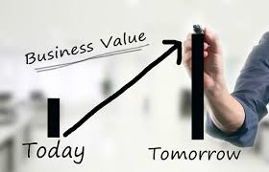


MIS782 Value of Information
Unit Introduction
https://www.youtube.com/watch?v=SF65qrAAEwU&ab_channel=DeakinUniversity

Slide 2


Content
Teaching team
Learning objectives and outcomes
What’s involved in this unit?
Weekly activities and assessments
Reading and learning materials

Slide 3

Unit Team
Unit Chair:
A/Prof Lubna Alam (lubna.alam@deakin.edu.au)
Professor Rens Scheepers (in Videos)
Seminar Facilitator:
Dr Ishan Senerathna (ishan.senarathna@deakin.edu.au)
Chintha Kaluarachchi (c.kaluarachchi@deakin.edu.au )
Peter Haddad (p.haddad@deakin.edu.au)
Kaushalya Nallaperuma (k.nallaperuma@deakin.edu.au)
Noor Nazneen (nnazneen@deakin.edu.au )

Slide 4
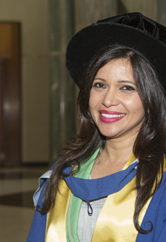
About me
A/Prof Lubna Alam
Associate Professor of Information Systems and RPL Co-Ordinator, Department of Information Systems and Business Analytics, Deakin Business School
PhD in Information Systems, The University of Canberra
Recipient of Vice-Chancellor's Excellence Award for Outstanding Contribution to Student Learning and Deans award for emerging researcher
Research: Central to my research is a focus on the nature of emerging, often disruptive, technology and information systems (e.g., social media, crowdsourcing, mobile technologies, AI) and their impact on individuals and organisations, with a particular focus on public sector and not-for-profits.
Media: contribute on several industry panels and is regularly invited for social issue commentary on TV, radio & the print media. Treasurer of ACPHIS (Australian Council of Professors and Heads of Schools), the peak body of IS professors in Australia.

Slide 5
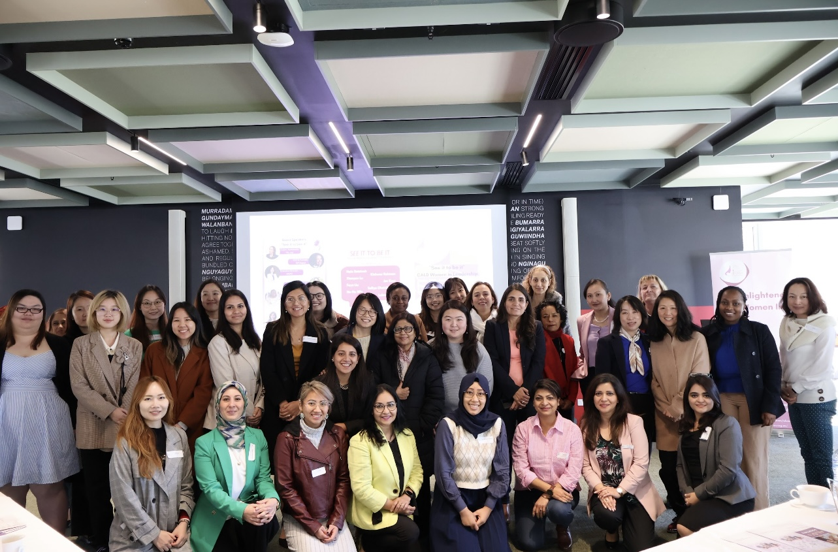
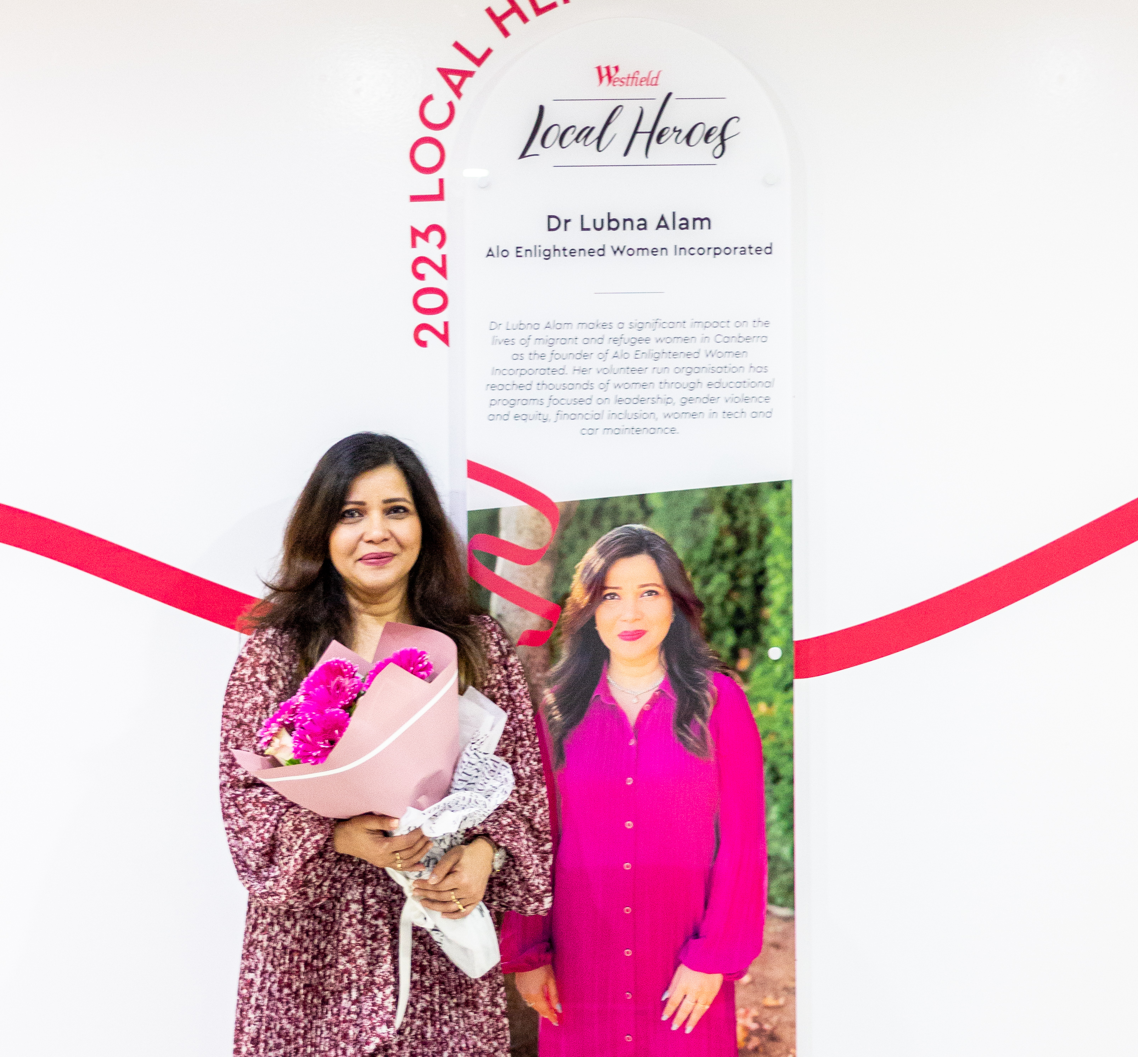
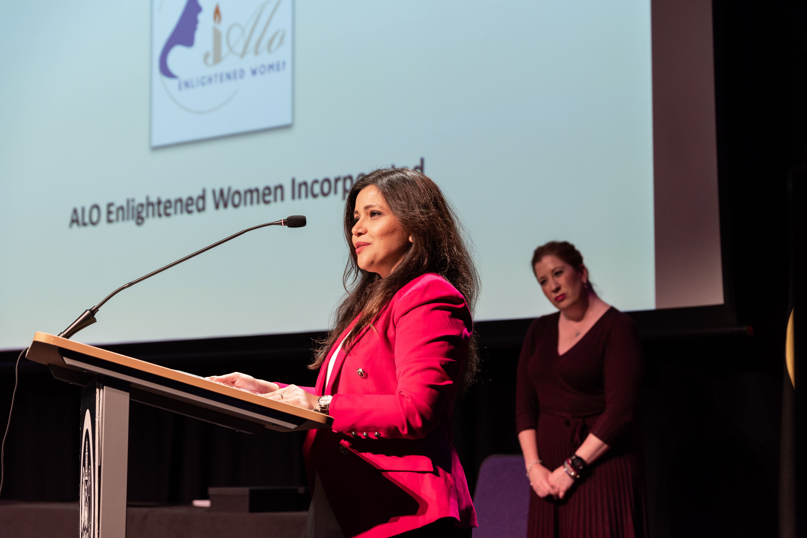

The ‘Other’ me
Founder of Alo - Enlightened Women Incorporated, (www.alowomen.org.au/)
Winner of prestigious ACT Multicultural Awards:
Finalist 2024 ACT Women of the Year
2023 Winner of the ‘ACT Outstanding Excellence Award for Diversity and Inclusion’
2023 Winner of the ‘ACT Community Organisation (Multicultural Champion) Award’
2023 Highly Commended in ‘ACT Multicultural Individual Champion Award.’
Winner 2023 Westfield Belconnen local hero, $20k community grant
Appointed for a 3-year term as a member on the new, 11-member, Ministerial Advisory Council for Multiculturalism (MACM).

Slide 6
Seminar tutors: First point of contact for assignment questions
Seminar 01 Wed 16:30 and online seminar Web 18:00 - Dr Lubna Alam (lubna.alam@deakin.edu.a
Seminars 04 Wed 16.30 and 09 Fri 11:00 - Dr Ishan Senarathna (ishan.senarathna@deakin.edu.au)
Seminars 13 Wed 18:00 and 06 Thu 16:30 - Dr Kaushalya Nallaperuma (k.nallaperuma@deakin.edu.au)
Seminars 02 Thu 9:00 - Dr Chintha Kaluarachchi (c.kaluarachchi@deakin.edu.au)

Slide 7

How?
Blended learning approach.
All materials and class activities have been created to support both on-campus and online study.
Students can use the online materials to study on-campus or online.
Students can choose to:
attend the class and seminars (on-campus or online)
study in their own time and at their own pace to complete learning activities and to submit assignments by the deadlines.

Slide 8


Delivery of the unit
Lecture:
On-campus and livestreamed via Zoom
Students are encouraged to join the lecture LIVE or listen to the recordings
Weekly lecture recordings will be available on the unit site on Wednesdays (after 9:00 PM) under Online classroom
Students are expected to read materials on the unit site before attending the lectures and seminars
Seminars:
On-campus seminar or online seminar (via Zoom).
Explain and condense the relevant material.
Include examples/ case studies illustrating methods used in business requirement analysis work.
Hands-on experience
Recordings for seminar activities will be made available on the unit site on Thursdays (after 9:00 PM- Melbourne time)

Slide 9

Assessment
Assignment 1 – IT Portfolio and RBV (1500 words)
Assignment 2 – Business case development (40%)
3 min Video presentations in week 8 in seminars (10%) and
Final report on (30%) - 3000 words
Assignment 3/End of assessment Task – (30%) – DCT and analytical report – 1500 words

Slide 10





Asking For Help
Weekly tutorials are the first point of seeking help from your respective tutors. Alternately, you can also use the following:
Email your tutor
Weekly discussion forums in CloudDeakin.
Assignment discussion forums for assignments
Email ONLY for queries of personal nature or assignment extension with unit chair strictly directed to lubna.alam@deakin.edu.au
Email MUST contain Unit Code in title: MIS782

Slide 11
Learning support services
Support Service | Where | Hours | Conditions
General study skills support: Goal setting and time management Note taking Online learning and digital study tools Getting organised Participating in discussions Oral presentations Group work Assignment writing assistance: Writing / structure English language Argument / idea development Referencing | Writing Mentors: on campus or online | Set times during trimester | No bookings required
 | Individual consultations with Language and Learning Advisers: on campus or via Skype | Until 8.30 pm Mon-Fri | Bookings required
 | Study Support: Email enquiries | All times | For shorter queries Replies within 24 hours on business days
Maths assistance: Coaching in solving problems Explanation of concepts and methodologies | Maths Mentors: drop in consultations on campus, via Skype or phone | Set times during trimester | No bookings required
 | Students Helping Students: Email enquiries | All times | For shorter queries Replies within 24 hours on business days
Unit specific assistance: Regular group sessions lead by a Peer Student Leader for selected units of study | Refer to PASS timetable for unit details and session times. | Set times during trimester – refer to timetable. | Register for interest in attending a PASS session.
Student Mentor Program: Experienced students share their knowledge to help you: Develop study skills Link to support services Increase your level of confidence with the learning environment Get to know new people Get involved | Refer to the Student Mentor Program page for details and to register |  | Registration required
 | Drop in Station Student Drop-in Station (DIS) | Set times during trimester – refer to timetable. | No bookings required

Slide 12
Plagiarism
See APA7 Referencing Style: https://www.deakin.edu.au/students/study-support/resources-and-referencing/referencing/referencing-explained/introduction
You must cite and acknowledge the sources of all information in your work (review question answers and assignment)
Citing the sources, paraphrasing and incorporating that paraphrasing in your work will increase your credibility and increase your mark
If unsure, please check Deakin University’s policy on plagiarism and referencing

Slide 13
Academic Integrity (HAI010, STP050, AAI018, MAI010)
All new Deakin students are required to complete this unit. There is no cost for this unit.
It does not contribute to your Weighted Average Mark (WAM) for your studies.
You will find the Tile for this unit in the ’My Learning’ area of DeakinHub, with your other units.
It will take about 2 hours.

Slide 14






Digital disruptions changing businesses

Slide 15
What changes
Examples of organisations that has been disrupted due to technological disruption
Kodak – didn’t see digital photography coming
Yahoo – didn’t see Google coming
Blockbuster – didn’t see Netflix coming
Border Books – didn’t see Amazon coming
Blackberry – didn’t see the iPhone coming
Taxi industry – didn’t see Uber coming

Slide 16
What is Information Worth?
Information has become an element of commerce…. yet there are no cogent, universally accepted accounting or economic theories of information.
There are various frameworks in which we try to view and define information, various attempts to measure it, decide what kind of value it has, and determine how much it is worth. …Clearly, placing value on information is not a straightforward, single-step process.
Information passes through many stages before it has value to anyone…We collect it, organize it, analyse it and draw conclusions from it. Both the information and our conclusions can be communicated. Only when information has been comprehended, can we value it and respond to it.
…Information has no value in itself; its value is derived from its understanding and subsequent application. …Society values only the product, or result, of information.
Source: Fenner (2002), Library Philosophy and Practice 4 (2).

Slide 17

Theme 1
What Business Value does IT bring?
Firms need to understand the value of IT investments:
´ What is business value?
´ How to gain value from ICT investment returns?
Notes:
Start with a question: should we invest in a technology? For example, IoTs? AI? Dig disruptions and big decisions.
IT investments need to generate a return, that is a business values – such as improved organisational performance, financial, new/product service, better decision making.
Business model is the primary way a business generates its revenue and competes in the market. It sets the context for understanding business value return.

Slide 18

Theme 2
Competitive Advantage
Firms need to understand how to gain competitive advantage from analytics and information:
What is competitive advantage?
How to gain competitive advantage based on underlying resources?
Strategic use of information
Notes:
A firm is said to have competitive advantage when it acquires or develop an attribute/or a combination of attributes that allows it to outperform its competitors by creating more economic value.

Slide 19



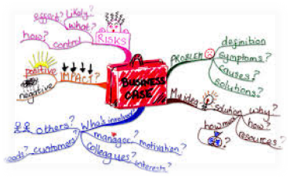
What This Unit Is About..
´ How to write a business case
Notes:
Ideas are ideas, to transform them into business ventures that results in competitive edge is an important consideration.
To sum up, you will discover ways of seeing through the complexities of business to make informed decisions about information and information capabilities.

Slide 20
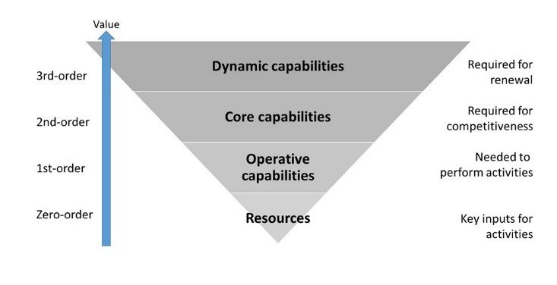
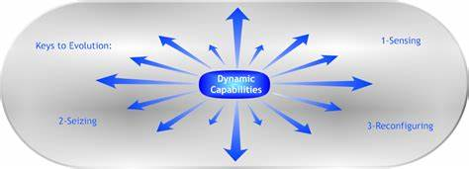
What This Unit Is About..
´ Dynamic capabilities and advances in technology
Notes:
Ideas are ideas, to transform them into business ventures that results in competitive edge is an important consideration.
To sum up, you will discover ways of seeing through the complexities of business to make informed decisions about information and information capabilities.

Slide 21
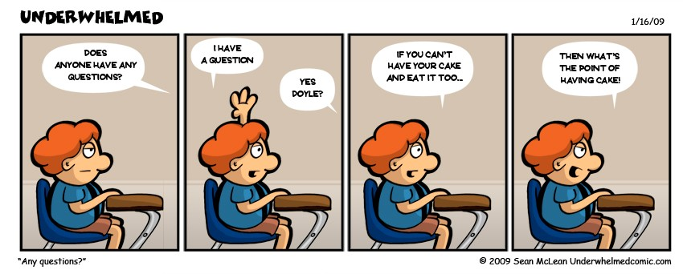
Questions?

Slide 22
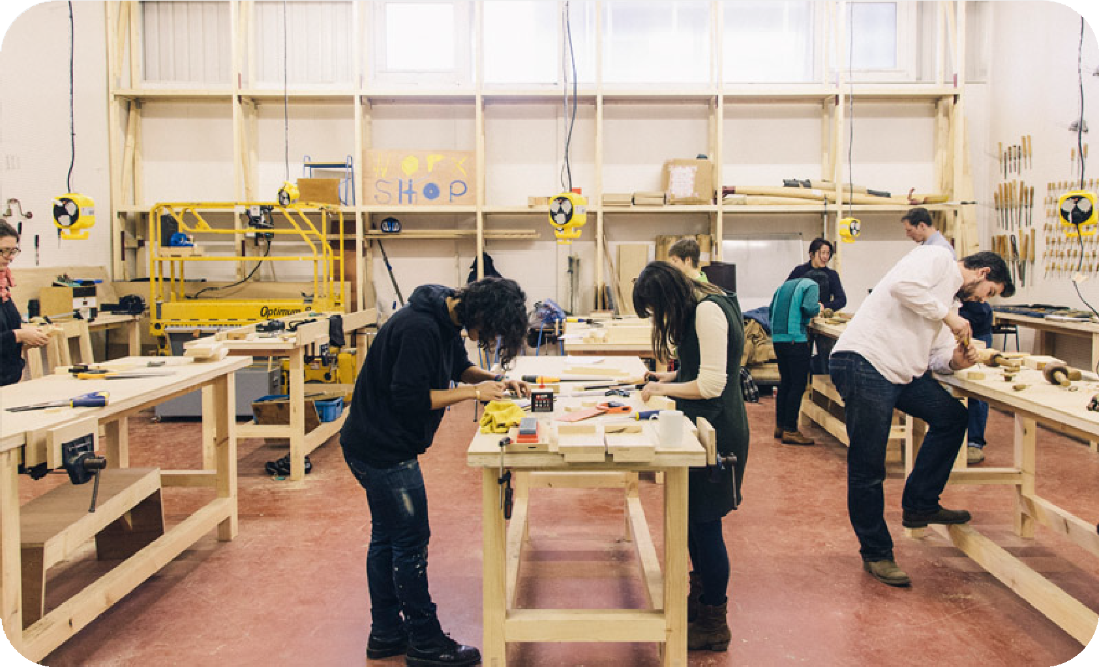
MIS782 Value of Information
Class Week 1 (Module 1)

Slide 23
Phenomenon, Abstraction, Application
Phenomenon (Business Value of Information):
Information as Competitive Resource
IT investments
Business value returns from IT investments
Abstraction:
Business Models
The IT Portfolio
Application of concepts through:
Class discussion, seminars, industry presentations
Case study
Assignment 1
Course 1 focus:
Discuss what is meant by the business value of IT through practical examples
Understand how information technologies can create business value

Slide 24
What is Business Value? Competitive advantage?
What is it?
Economic value? Revenue generation capabilities?
Task
Airlines have had an in-flight service since the inception of air travel. Should we introduce a similar service in our public transportation system?
https://padlet.com/lubnaalam/mis782

Slide 25
How do we understand business value?
We understand business value in the context of the organization’s business model, i.e., how it generates income, develops and deploys resources develops capabilities (Refer Courses 2,3,4) and competes in its environment

Slide 26
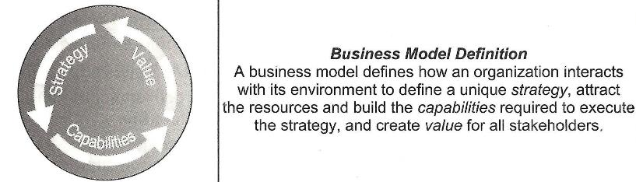
Business Models
“…the logic of the firm, the way it operates and how it creates value for its stakeholders.”
Casadesus-Masanell & Rickart, 2009
Applegate reading, Chapters 1-3

Slide 27
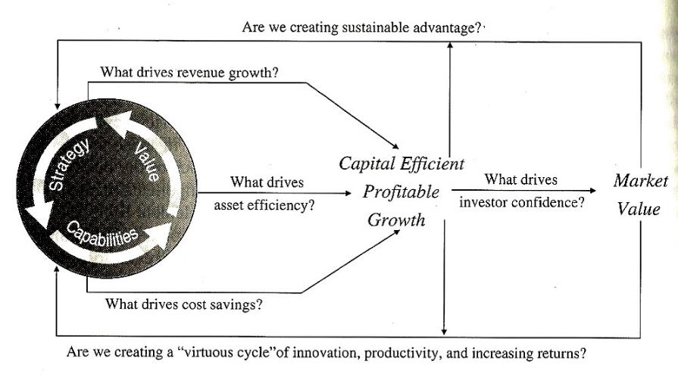
Analysing Business Models
Applegate reading, p.50

Slide 28
Business Model Strategy Audit
Business Context
Business Network
Competition Collaboration
Customer Analyses
Competition Analyses
Applegate reading, p.54

Slide 29
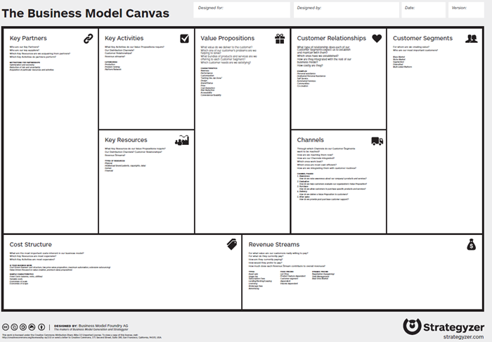
Business Canvas
https://strategyzer.com/canvas/business-model-canvas

Slide 30
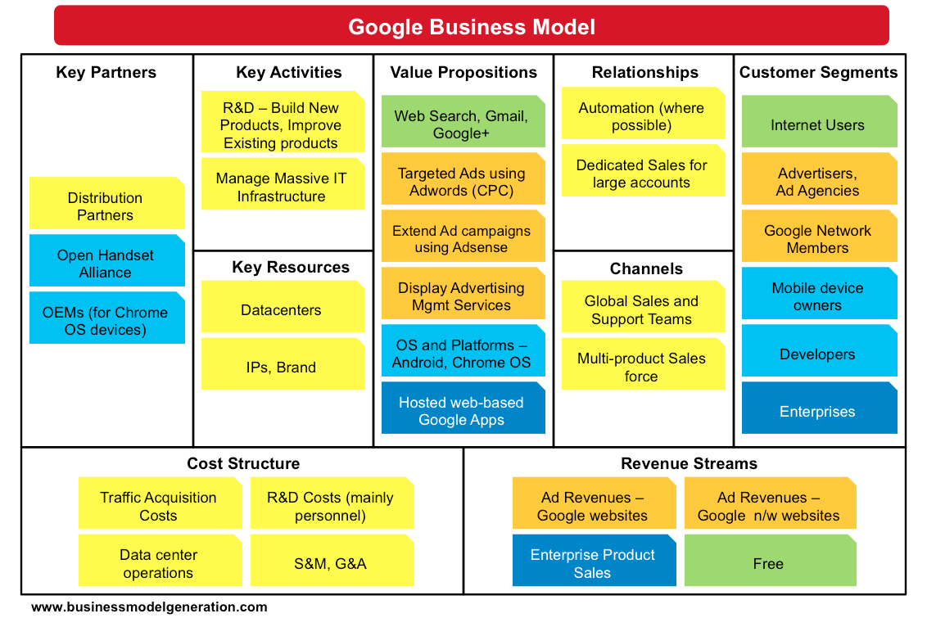
Business Canvas - Google

Slide 31
Evolving Business Models
Business Models are not static, they evolve:
Enhance:
Incremental improvements to an existing strategy or capability
Expand:
Launce new product categories, enter new markets, or expand capability
Explore:
Launce new businesses and build new capabilities
Exit:
Exit a product or market or outsource a capability
Applegate, p.51

Slide 32
Business-IT alignment
(Refer Chan & Reich (2007) reading)

Slide 33
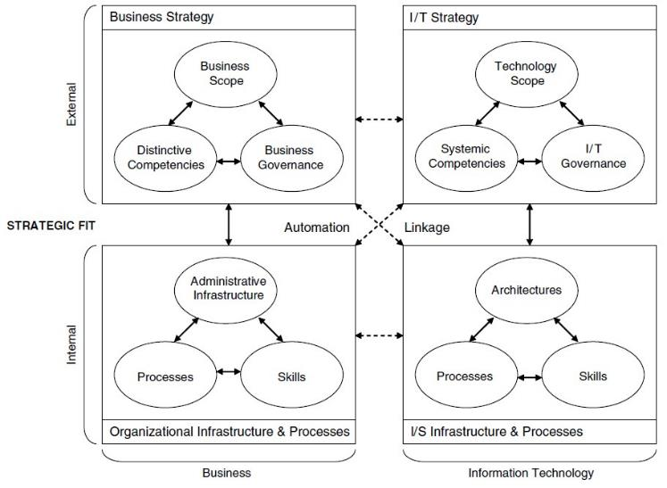
Strategic Alignment Model
(Henderson & Venkatraman, 1993)

Slide 34
BEST PRACTICES IN UNDERSTANDING IT VALUE
Link IT value directly to your business model.
Recognize value is subjective and manage perceptions accordingly.
Aim for a value “win-win” across processes, work units and individuals.
Seek business commitment to all IT projects.
Manage value over time.
Source: Smith & McKeen (2003)

Slide 35
How IT Creates Business Value: a Process Theory
“The IT conversion process”
“The IT use process”
“The competitive process”
IT
expenditure
IT
assets
IT
impacts
Organizational performance
•IT management
•Conversion activities
•Competitive position
•Competitive dynamics
•Appropriate use
•Inappropriate use
(Soh & Markus, 1997)
Notes:
Organisations spend on IT. And subject to

Slide 36
Hierarchy of Impact of IT Investments
•Revenue growth
•Return of assets
•Revenue by employee
Business-Unit Financial Business Value
Impact Sought
Business value measures
•Time to bring a new product to market
•Sales from new products
•Product/service quality
Business-Unit Operational Business Value
•Time to implement a new application
•Cost to implement a new application
Dilution of Impact
Business-Unit IT Applications Business Value
IT $
•Infrastructure availability
•Cost per transaction
Firmwide IT Infrastructure Business Value
•Cost per workstation
IT $
Time
Weill & Broadbent (1998)

Slide 37
Next Seminar Week 2……
Seminars starts from week 2!!
Have you enrolled in one yet?
On-campus students through STAR
ONLINE students JOIN LIVE
CloudDeakin >online Classroom > ZOOM SSO > Seminar/lecture

